Slide 1
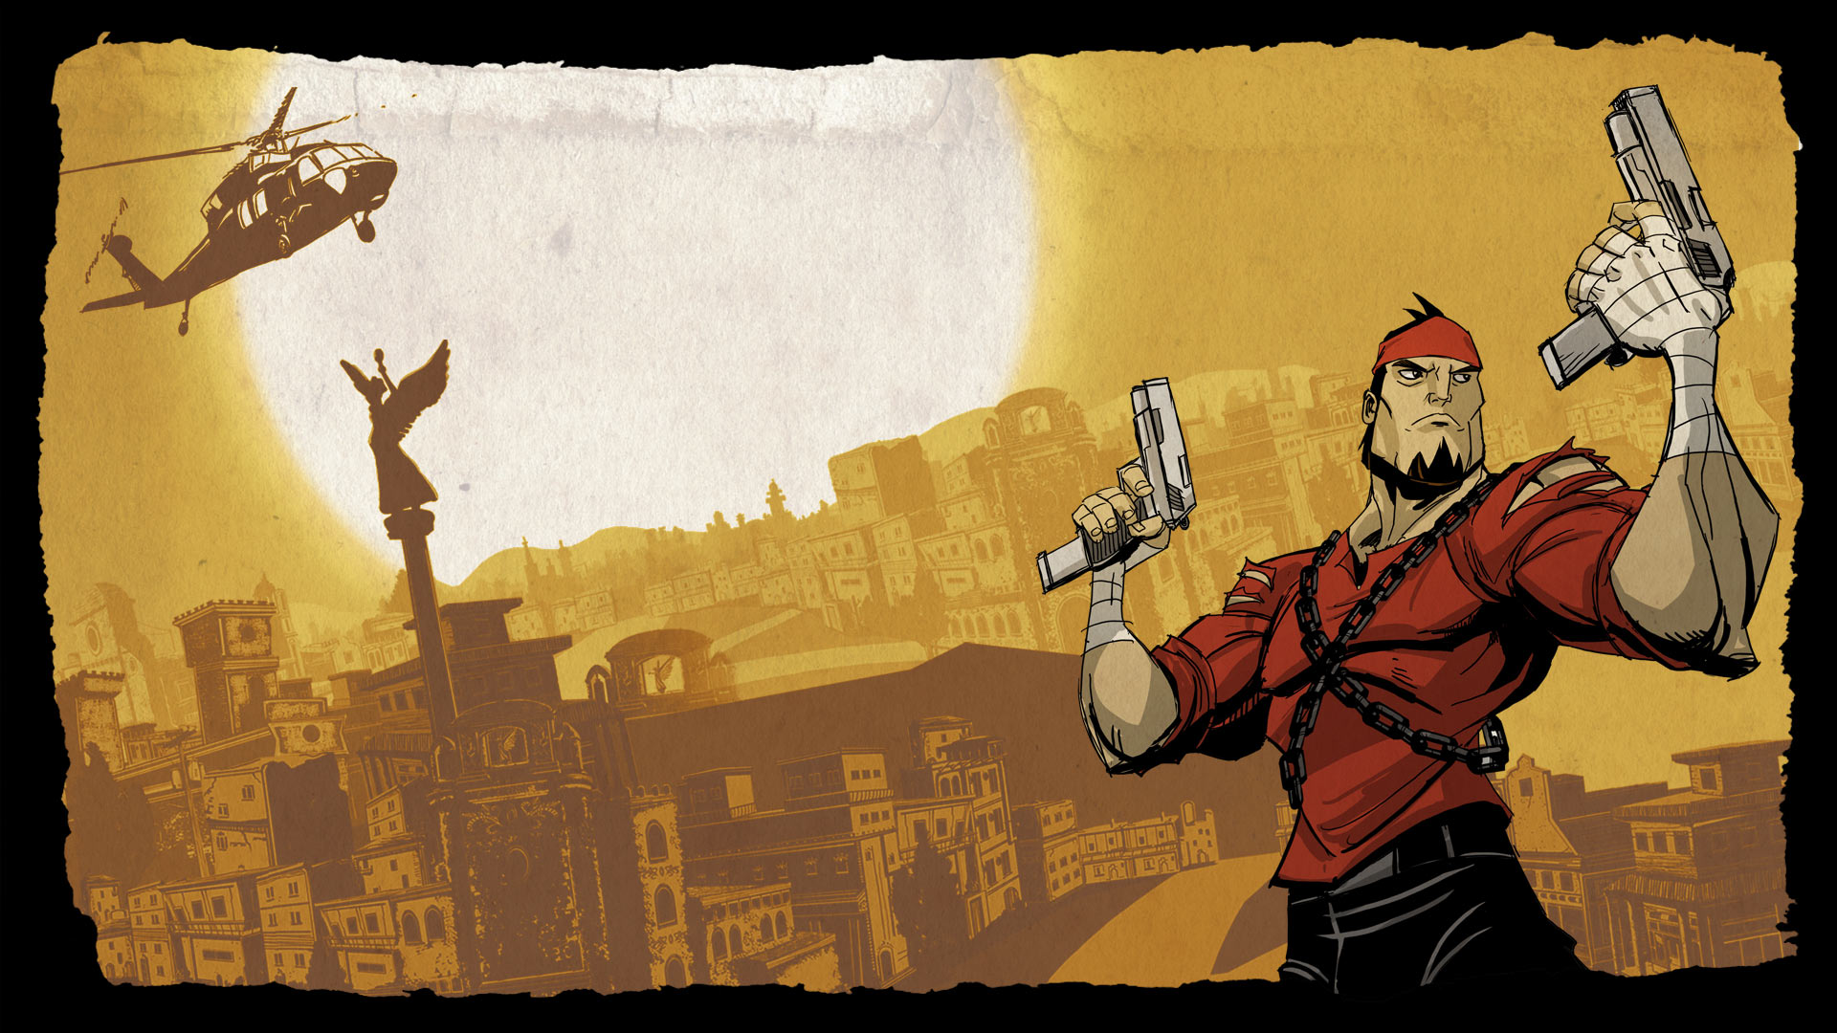
GAME ART INTENSIVE

Slide 2
Today we’re look at animation principles a bit more in depth
Word of the day:
#ANIMATION

Slide 3
ANIMATION
The illusion of life.
Animating pixel art can be tricky.
When we work in 3D, most of the work is in creating the model and the rig.
When we work in 2D, you need to redo all of the work, every frame.
Specifically when it comes to using different camera angles or perspectives.
Isometric or ¾ perspectives are in particular, difficult to visualize and keep on model.
Lets look at the principles of animation to really get to know what we’re working with.

Slide 4
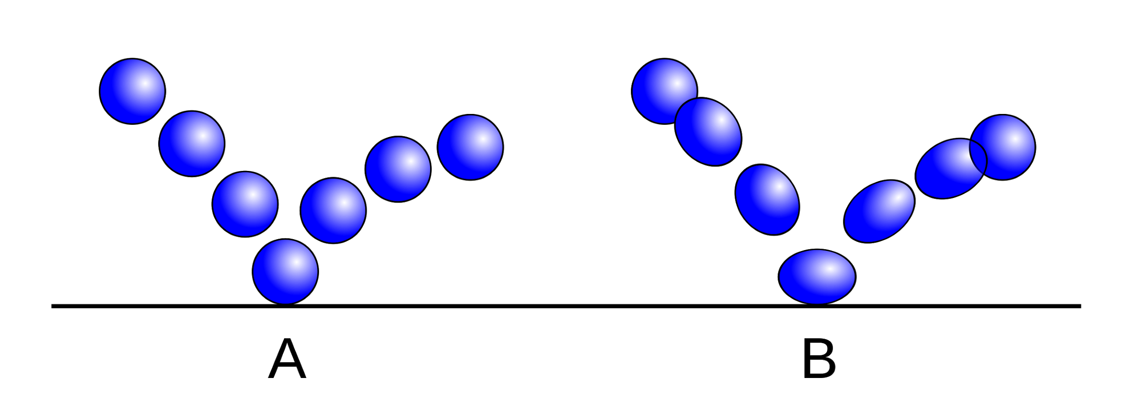

Slide 5
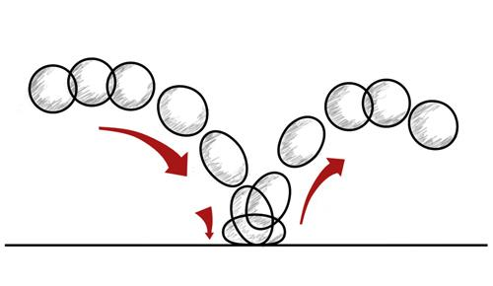
ANIMATION
The first principle of animation is: Squash and Stretch
Squash and stretch translates to “transfer of weight and motion”.

Slide 6
ANIMATION
When something is accelerating/moving faster, we tend to see it get longer (stretch)
When something decelerates, or slows down, we see it compress (squash)

Slide 7
ANIMATION
This effect isn’t just useful for exaggerated cartoony work
It’s useful to put squash and stretch into a lot of animations, to help it read better.
*Generally speaking, you can’t push this too far!*

Slide 8
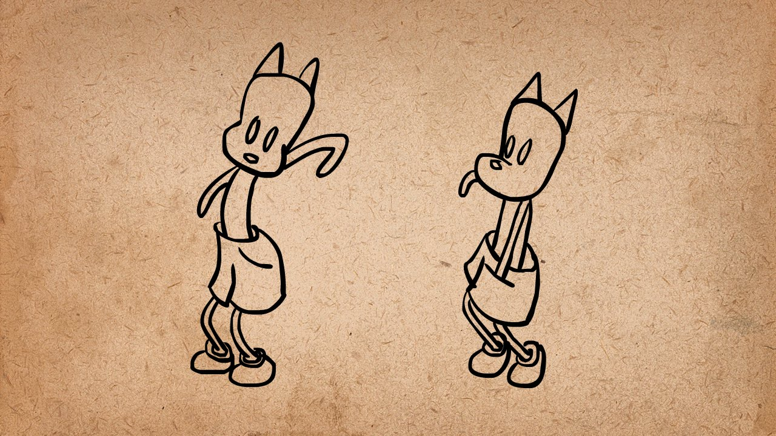

Slide 9
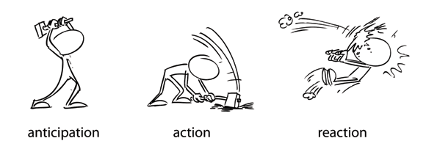
ANIMATION
The second principle is Anticipation
It is the thing that happens, before the thing that happens

Slide 10
ANIMATION
Anticipation is the motion that occurs in the short moment before a major motion
This helps sell the realism in an animation
It’s about having a tell, or a call out to show what is coming up

Slide 11
ANIMATION
The “flow” of an animation can be seen above. Anticipation” > “Action” > “Reaction”
Anticipation is when you bend down a little just before a jump.
Anticipation is when a pitcher winds up before releasing a baseball.
Anticipation is when a golfer does a back swing before the follow through.

Slide 12
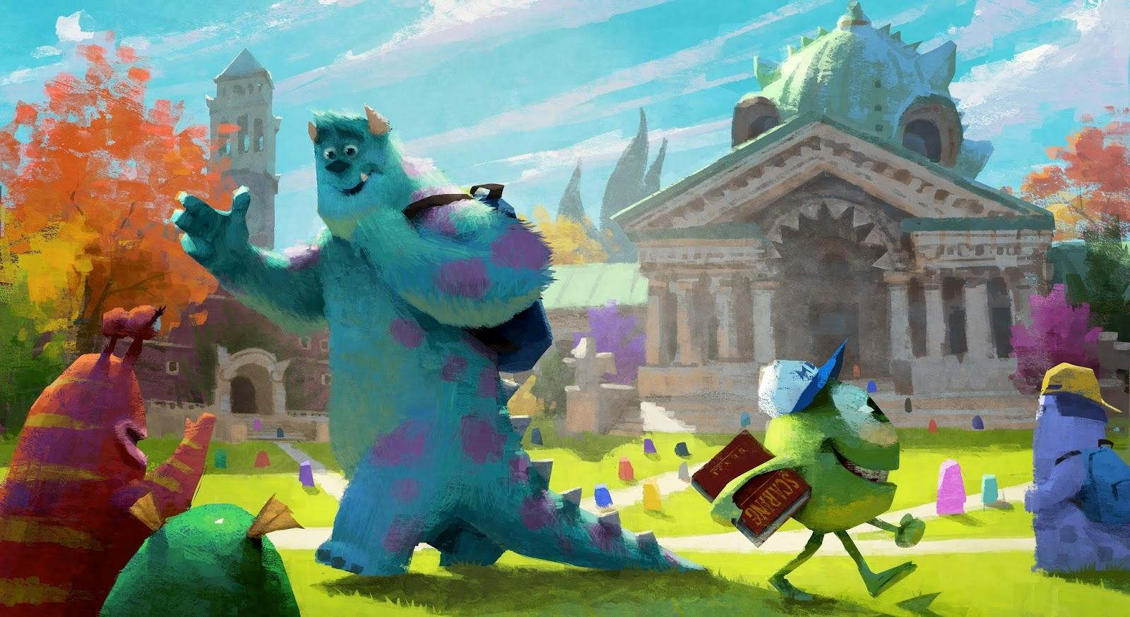

Slide 13
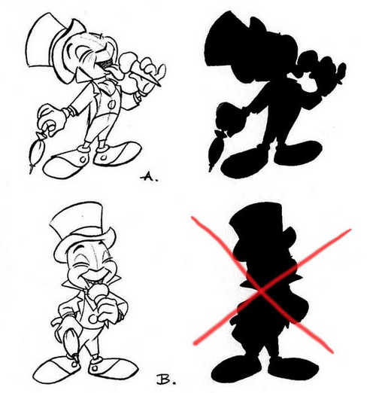
ANIMATION
The third principle is Staging
Staging really means “directing the attention of the viewer”

Slide 14
ANIMATION
This means camera placement, or where the characters are in the frame
It also means the use of light and shadow
But what it all boils down to is how to best present your idea or image

Slide 15
ANIMATION
Think of Staging in terms of silhouettes
Take your image, and then turn it into a black and white (no grey) image
Do the forms read properly???

Slide 16
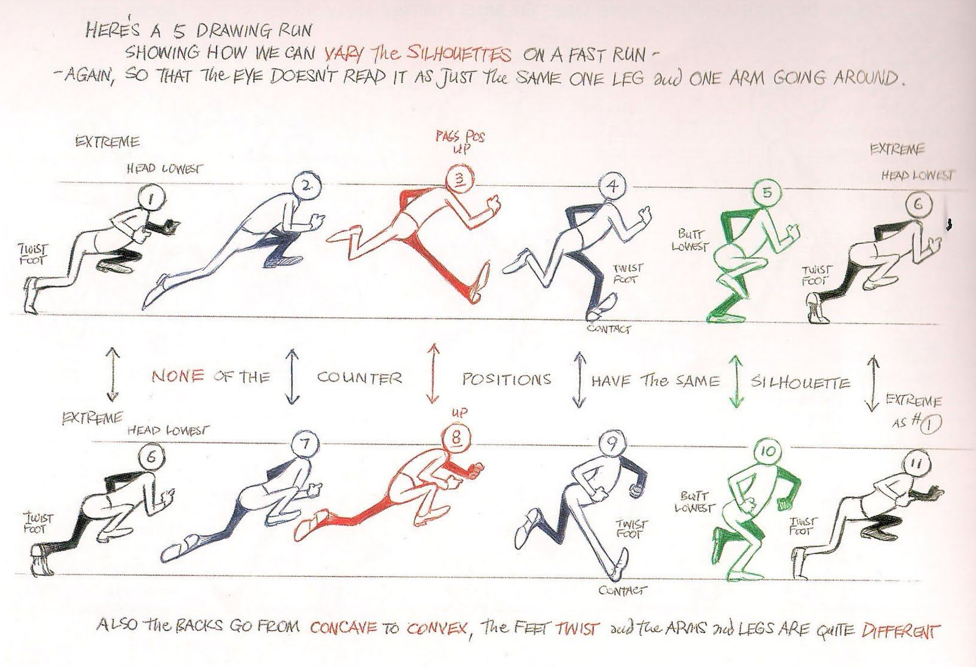

Slide 17
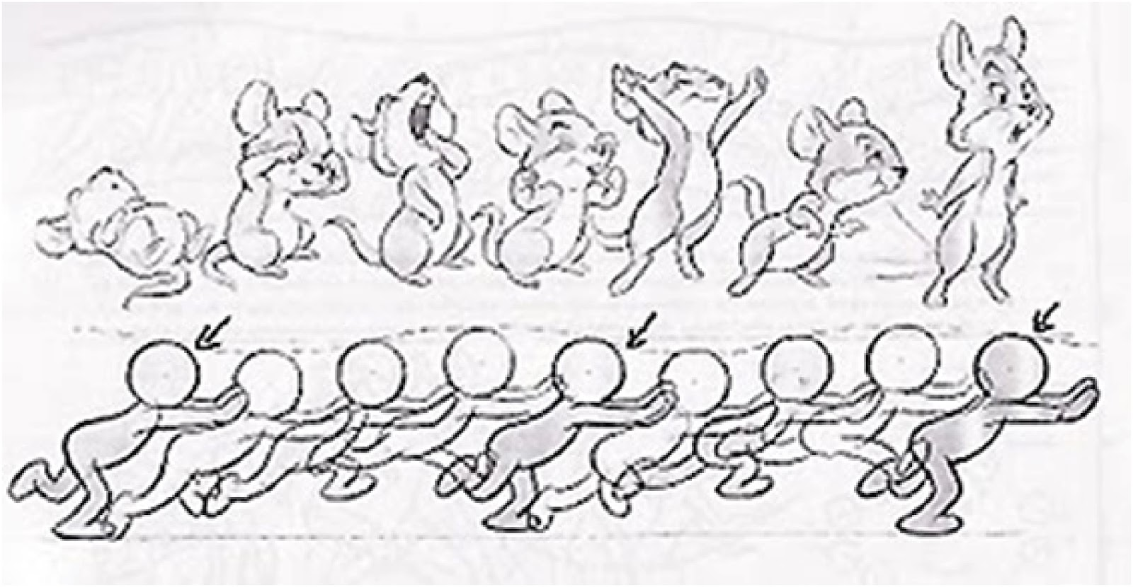
ANIMATION
The fourth principle is Straight ahead and Pose to pose
Straight ahead refers to animating frame by frame, animating a scene from beginning to end.
Pose to pose refers to animating based on a few key frames, and adding in between frames later.

Slide 18
ANIMATION
Straight ahead animation is generally use for creating action sequences.
Sword fights, dancing, etc.
It’s used less in 3D, and more in 2D.

Slide 19
ANIMATION
Pose to pose animation is a widely used method.
Most of the time in 3D, we key frames and the program does the in-betweens.
For 2D, the advantage is having two strong poses to animate between.
By having strong key frames, it’s easier to stay on model, or to scale.

Slide 20
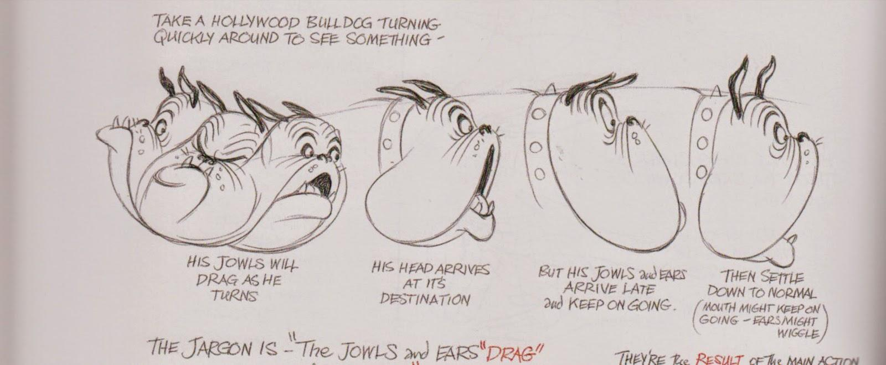

Slide 21
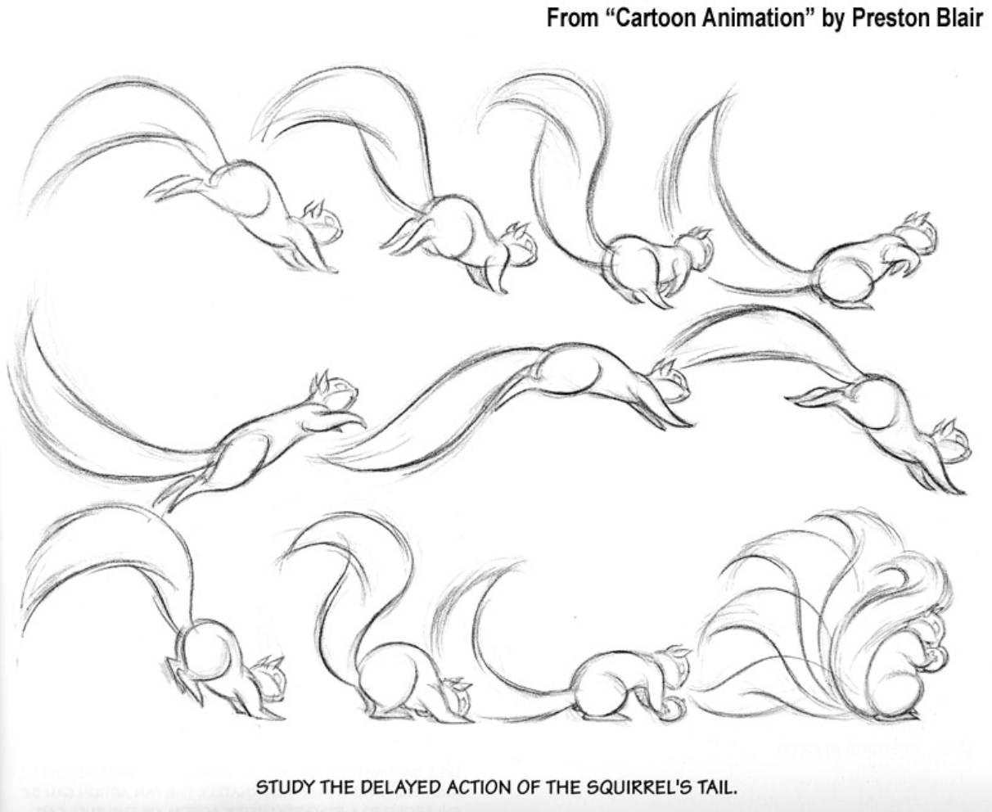
ANIMATION
The fifth principle is Follow through/overlapping action
Two closely related techniques to make animation more realistic
This makes it much more believable that a character has actual physical properties

Slide 22
ANIMATION
Follow through can be shown when a character stops moving forward
This is when hair, or limbs continue to move forward after the body has stopped

Slide 23
ANIMATION
Overlapping action is when parts of the body are moving at different speeds
For example, arms and legs move at different times/speeds during a run cycle
When your right leg is forward… Where is your right arm?

Slide 24
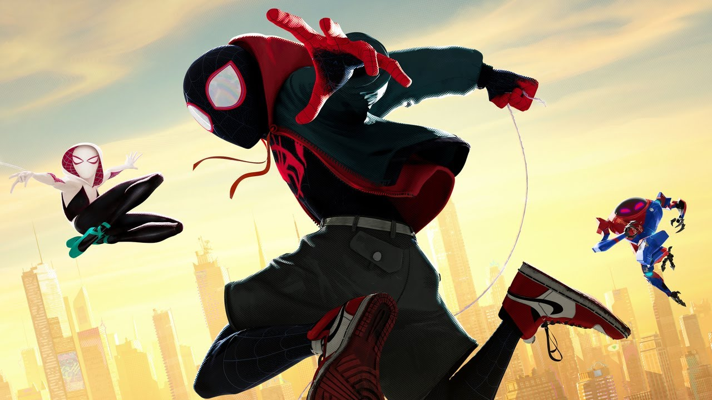

Slide 25
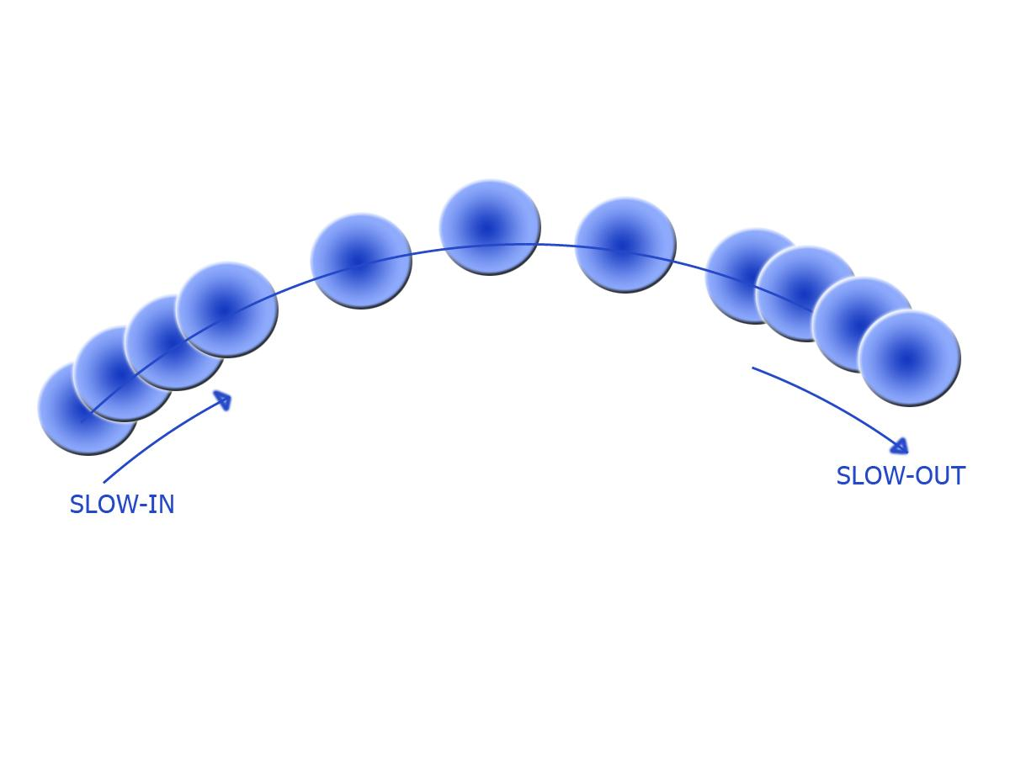
ANIMATION
The sixth principle is Slow in, slow out
This refers to the time needed to speed up or slow down an object
Whether it’s starting to walk, or throwing a punch, you don’t start at 100% speed!

Slide 26
ANIMATION
Slow in is all about acceleration or getting up to speed
It may only take a couple of frames to get there, but don’t underestimate its effectiveness
The amount of weight that it portrays is important

Slide 27
ANIMATION
Slow out is the end of an animation
Unless you’re crashing a car into a building, you have a slow out
This is where you have a couple of frames of slowing to a stop

Slide 28
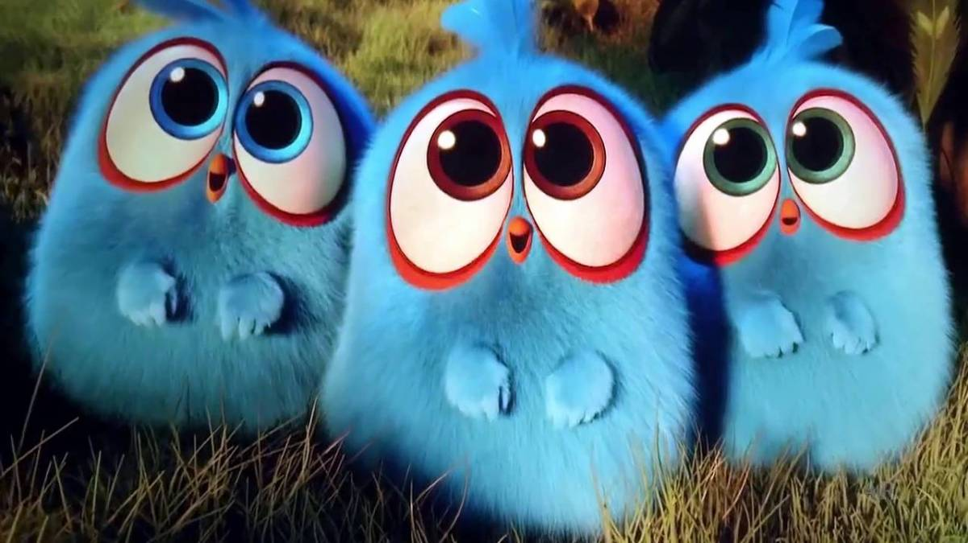

Slide 29
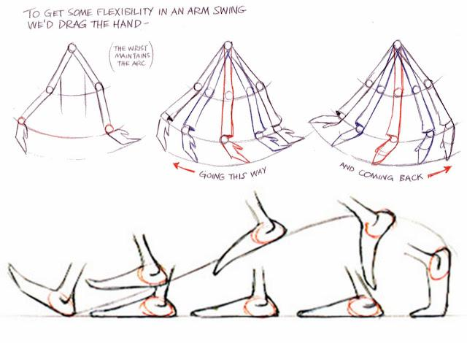
ANIMATION
The seventh principle is “The Arc”
Natural motion is hardly ever in a straight line
There is almost always at least a subtle curve to be observed

Slide 30
ANIMATION
The higher the speed of an object, the less of an arc...
The straighter the line
The slower the object, the more pronounced the arc becomes

Slide 31
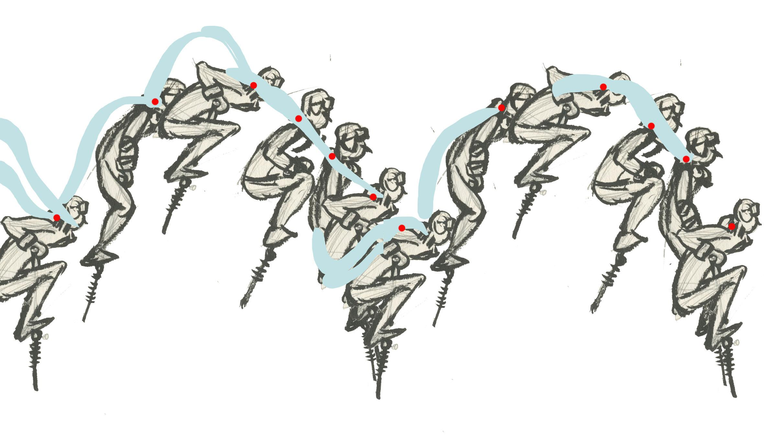
ANIMATION
The eighth principle is Secondary motion
Secondary motion adds life to an animation
It is motion that is layered on top of the core animation

Slide 32
ANIMATION
It’s the hair, that bounces with a walk
It’s the shield or backpack that bounces as the character runs along the path
It’s the long coat or anything else that is added on, over and above the basics

Slide 33


Slide 34
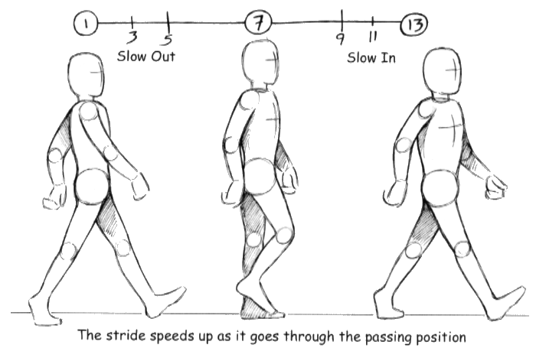
ANIMATION
The ninth principle is “Timing”
Timing is everything
In animation, timing is the number of frames or images that it takes to complete an action

Slide 35
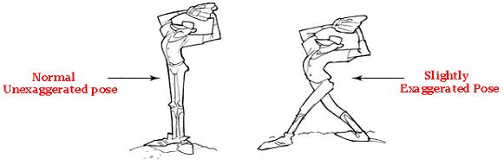
ANIMATION
The tenth principle is Exaggeration
Blowing things out of proportion too much can come off as unrealistic, or cartoony
That said, pushing things slightly past reality can help avoid the “uncanny valley”

Slide 36
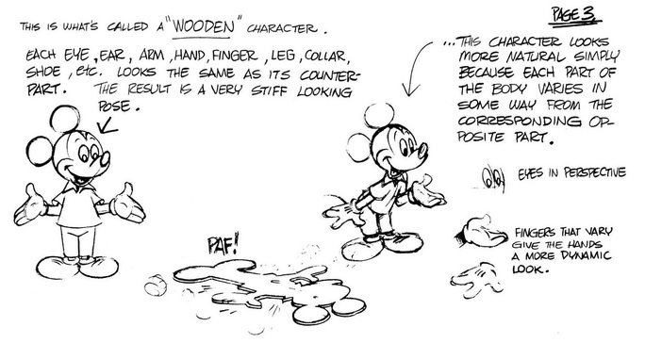
ANIMATION
The eleventh principle is Solid drawing
This is in reference to giving images weight, depth and volume
A flat pose, or flat drawing can ruin a lot of hard work and time

Slide 37
ANIMATION
Give weight to the poses, the character, the prop.
What ever it is that you’re working on, ensure that it “reads” well when you look at it

Slide 38
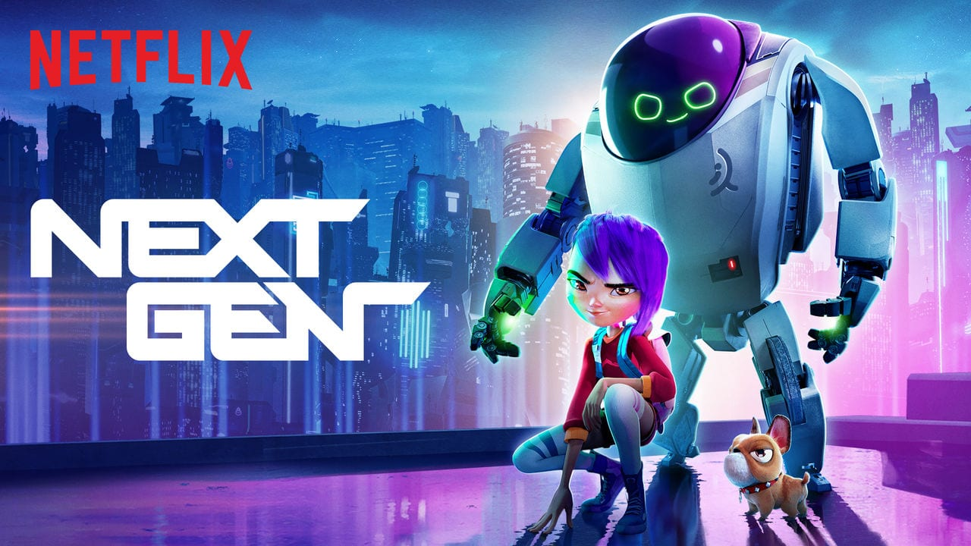

Slide 39
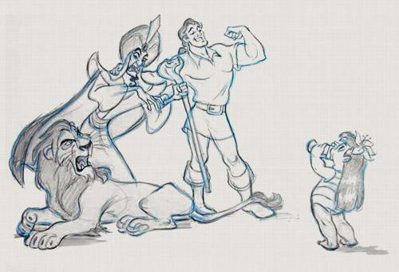
ANIMATION
The twelfth principle is Appeal
A character without appeal or charisma is hardly a character at all

Slide 40
ANIMATION
Appeal need not be limited to the hero
Villains and NPC’s can all have appeal
To create likeable characters, a certain degree of symmetry in the face, or baby like features

Slide 41

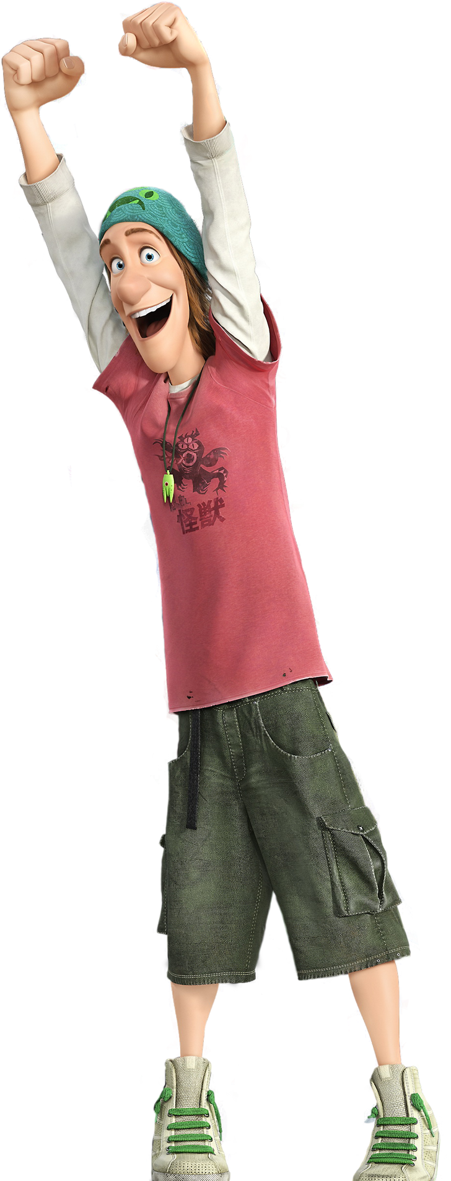
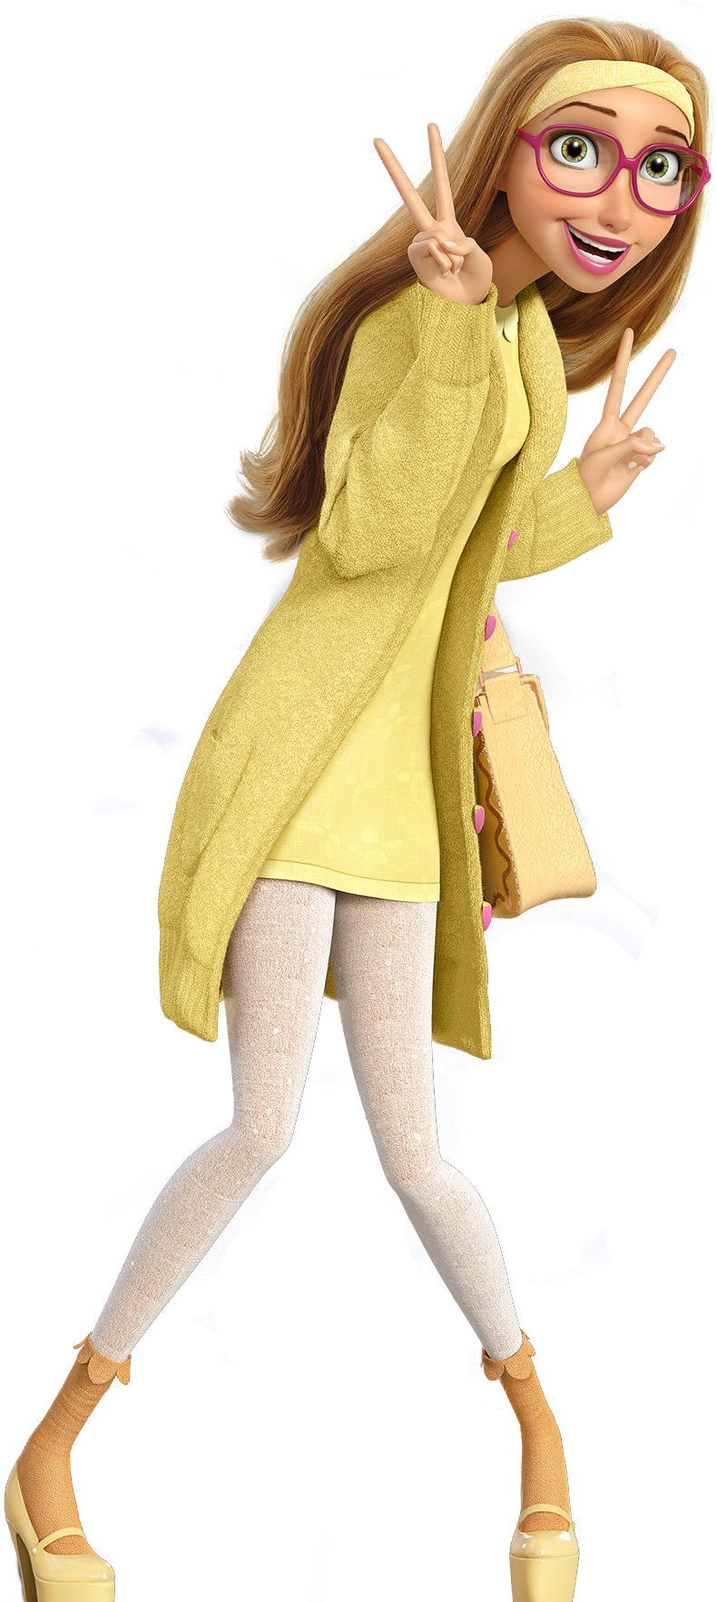
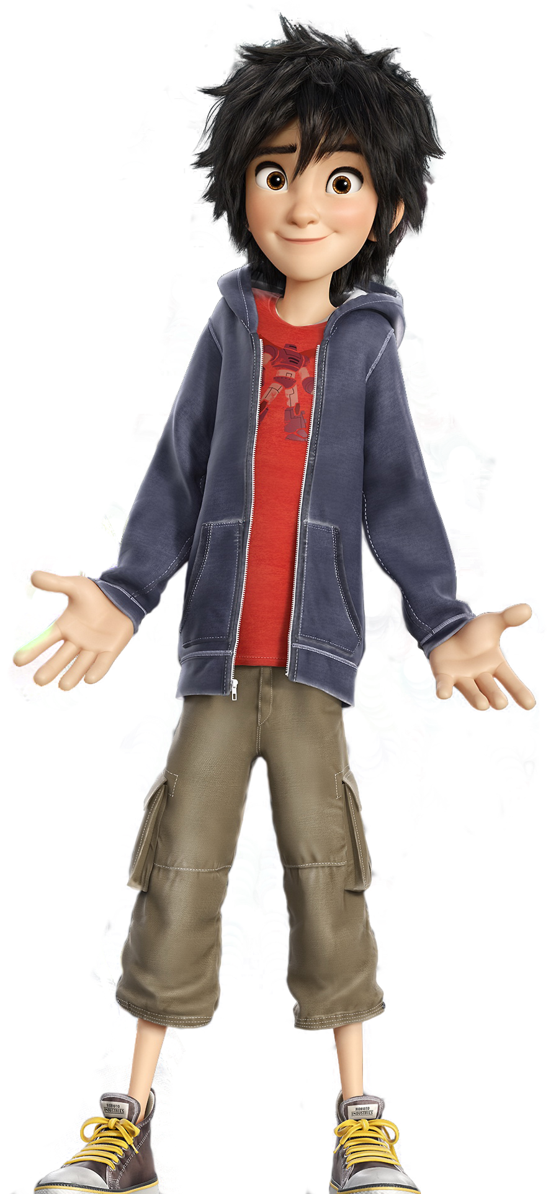
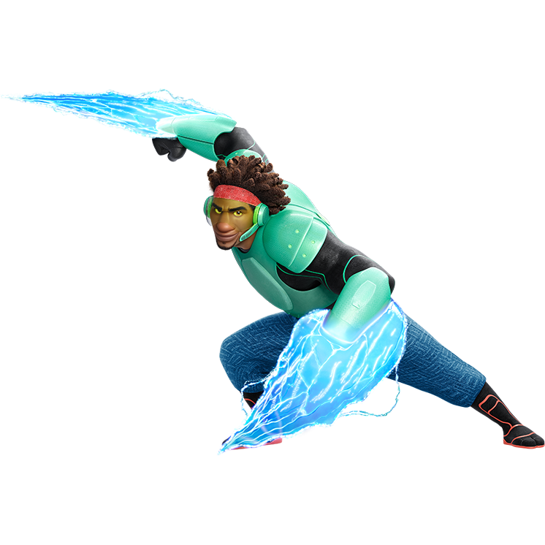
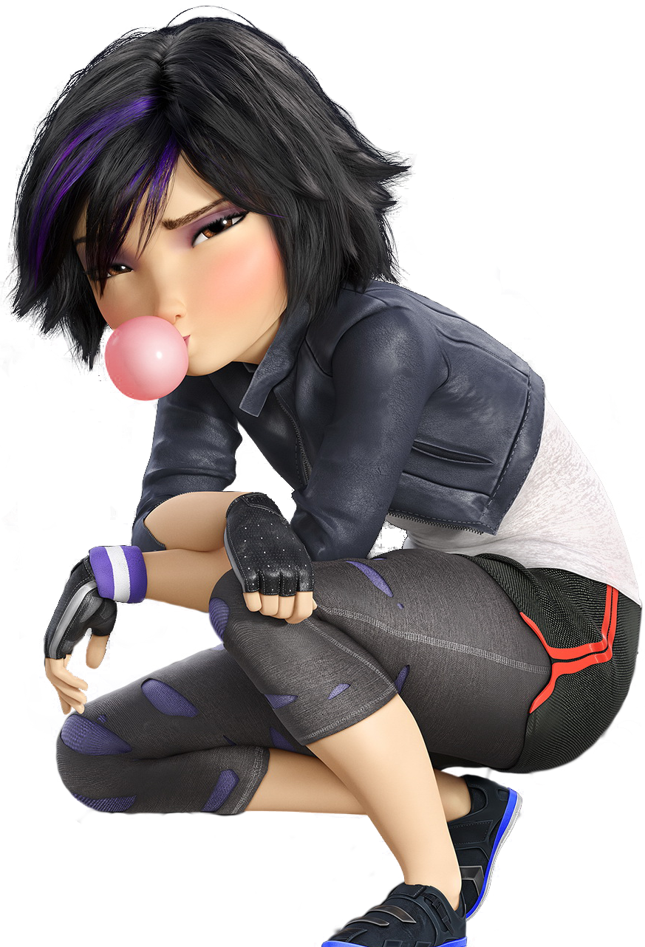
ANIMATION

Slide 42
RESOURCES
After:
Build a Pixel Building: http://www.idigitalemotion.com/tutorials/guest/pixel/pixel.html
Dithering/Shading: http://fc08.deviantart.net/fs24/f/2007/317/b/9/DITHERING_TUTORIAL___Basics_by_kitted.png
Pixel art anime eyes: http://fc05.deviantart.net/fs71/f/2012/127/e/0/pixel_eye_tutorial_by_topachi-d4yui7a.png
Isometric building: http://design.tutsplus.com/tutorials/create-an-isometric-pixel-art-apartment-building-in-adobe-photoshop--cms-23006
Isometric car: http://design.tutsplus.com/tutorials/how-to-create-an-isometric-pixel-art-vehicle-in-adobe-photoshop--cms-22550
Isometric character: http://design.tutsplus.com/tutorials/create-an-isometric-pixel-art-character-in-adobe-photoshop--cms-21825
Funny tutorial: http://fc06.deviantart.net/fs15/f/2007/104/d/2/Titan_Statue__Tutorial_by_The_Titan.png
Great read: http://gas13.ru/v3/tutorials/sywtbapa_almighty_grass_tile.php
Great read: http://www.pixeljoint.com/forum/forum_posts.asp?TID=11299

Slide 43
Build an Avatar!

